Slide 1
Capstone Project - 1
Airbnb Booking Analysis Team Members Fouziya Afreen Sumit Giri Rajkumar k

Slide 2

Lets Analyze the Bookings
Introduction to EDA
Importance of EDA
Defining problem statement
Data summary
Data Visualization
Conclusion

Slide 3
Introduction to EDA
Exploratory Data Analysis refers to the critical process of performing initial investigations on data so as to discover patterns, to spot anomalies, to test hypothesis and to check assumptions with the help of summary statistics and graphical representations.
It is a good practice to understand the data first and try to gather as many insights from it.

Slide 4
Importance of EDA
Identifying the most important variables/features in your dataset
Checking assumptions related to the dataset
To check the quality of data for further processing and cleaning to deliver data-driven insights to business stakeholders
Verify expected relationships actually exist in the data, to find unexpected structure or insights in the data

Slide 5
What is Airbnb?
Airbnb is a online community marketplace that connects people, who are looking to rent their homes with the people who are looking for accommodation
Founded in San Francisco in 2008 as a start-up , the company has become a worldwide booking platform
Today it contributes to the movement of more than 60 million people in 192 countries

Slide 6
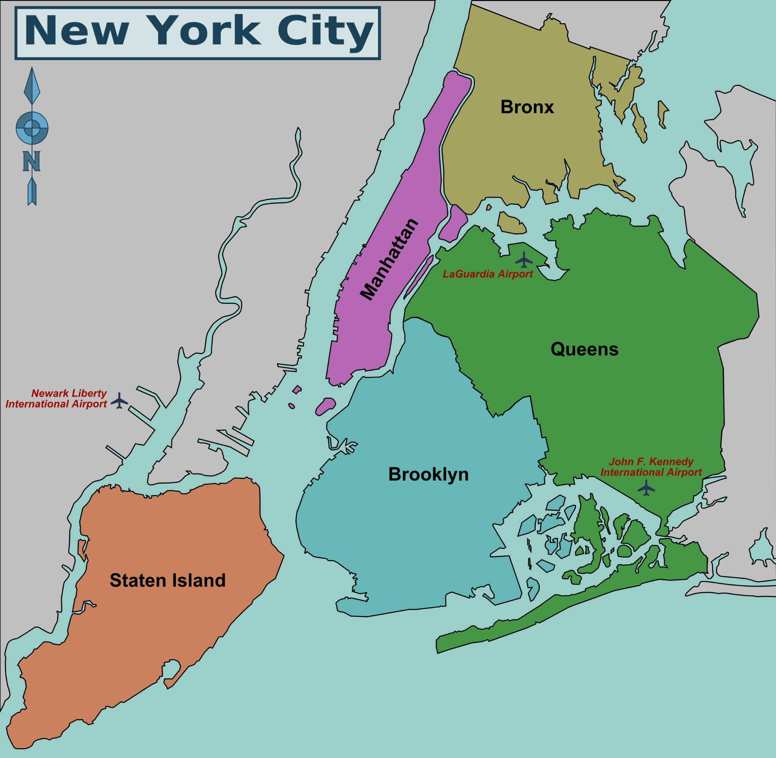
Defining Problem Statement

Slide 7
Defining Problem Statement
To Understand the problem we should know:
which neighborhood group has maximum number of hosts
which neighborhood has minimum price
which room type has maximum review
Maximum nights preferred by the hosts

Slide 8
Data summary
This dataset has around 49,000 observations in it with 16 columns and it is a mix between categorical and numeric values.
After loading the dataset we can see these 16 columns provide a very rich amount of information for deep data exploration we can do on this dataset. We do already see some missing values, which will require cleaning and handling of NaN values.

Slide 9
Data summary
Understanding unique values and categorical data that we have in our dataset, It looks like for those columns values we will be doing some mapping to prepare the dataset for analysis.
This data file includes all needed information to find out more about hosts, geographical availability, necessary metrics to make predictions and draw conclusions

Slide 10
Column Description
Id: unique value for every observation
Name: every id has unique name
Host id: unique guest id
Host name: guest name
Neighborhood group: 5 unique values
Neighborhood: areas under neighborhood group
Latitude & Longitude: geographical location of areas

Slide 11
Column Description
Room type: private room, shared room and entire home or apartment
Price: price of every room type
minimum nights: Total number of nights stayed
number of reviews: Total no. of review in percentage
Last review: date of last reviewed
Availability 365: Number of days available in year.

Slide 12
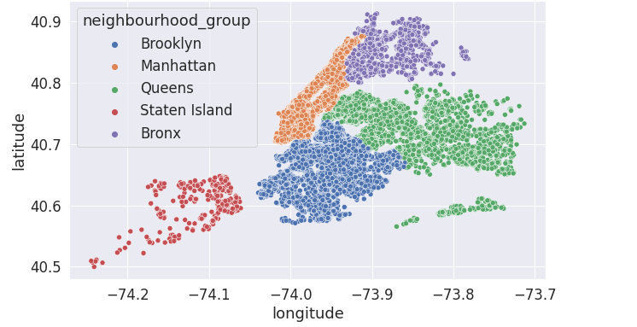
Location of neighbourhood groups

Slide 13
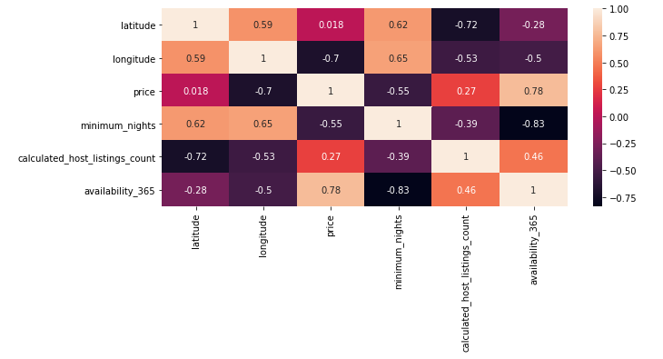
EDA

Slide 14
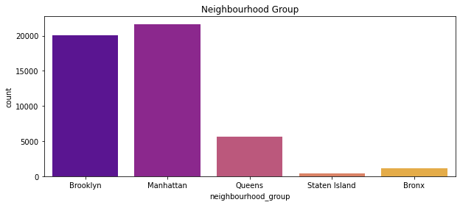
Most Visited Areas
This Shows that most of Airbnb Listings in New York are near Brooklyn and Manhattan

Slide 15
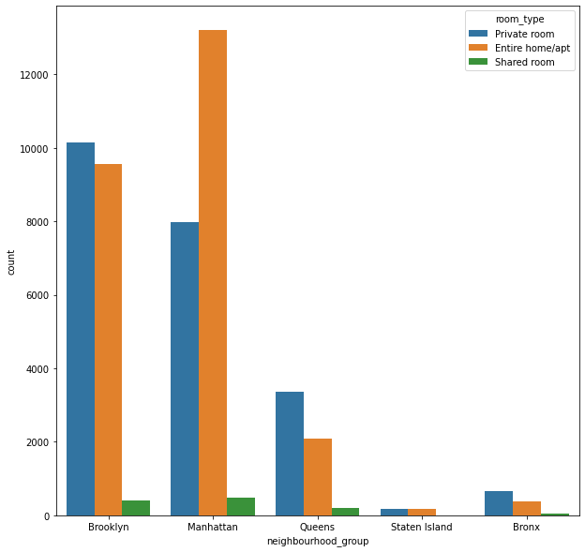
Comparison of Rooms

Slide 16
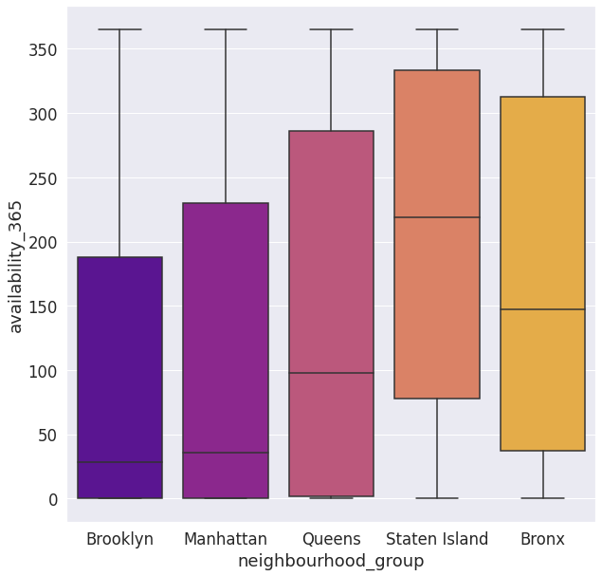
Availability of rooms

Slide 17
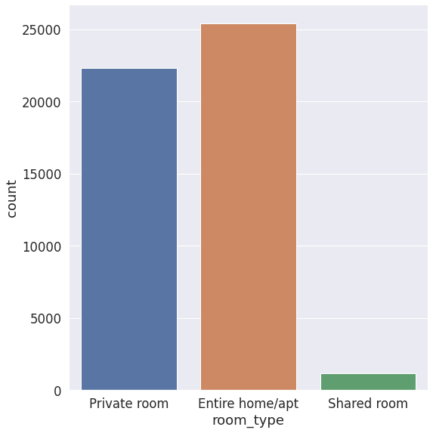
Preferred Room types

Slide 18
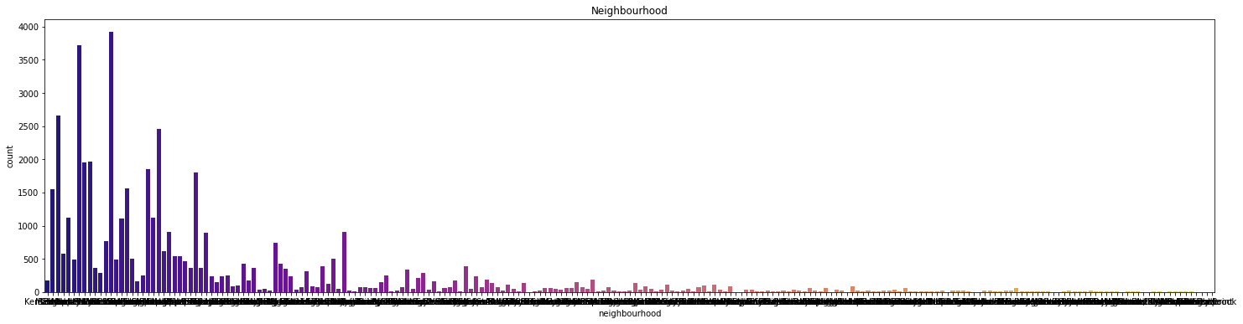
Popular Neighbourhood

Slide 19
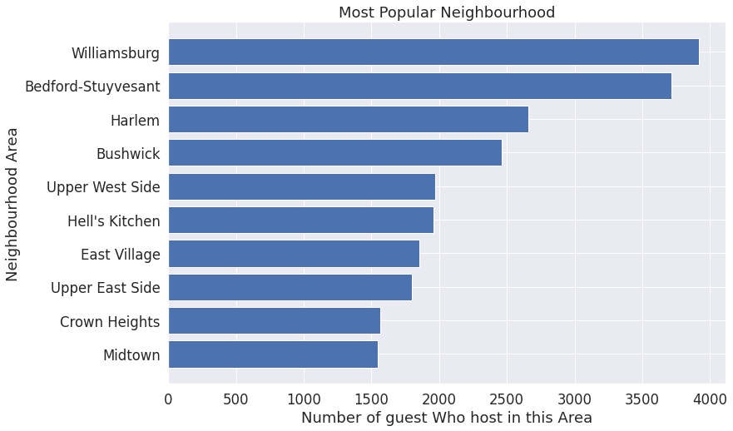
Popular Neighbourhood (continued)

Slide 20
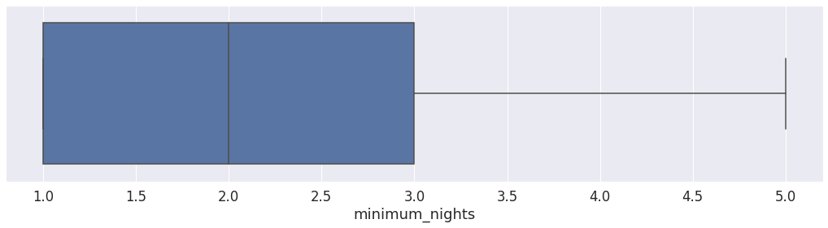
Maximum Stay

Slide 21
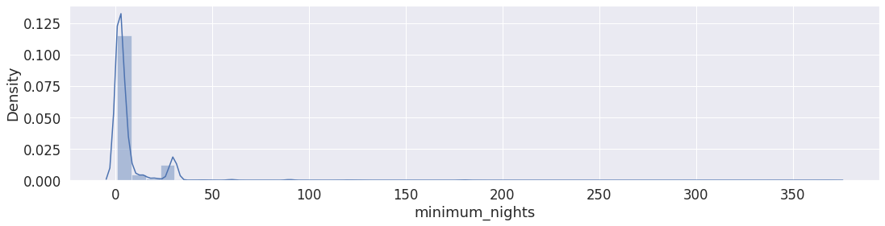
Maximum Stay (continued)

Slide 22
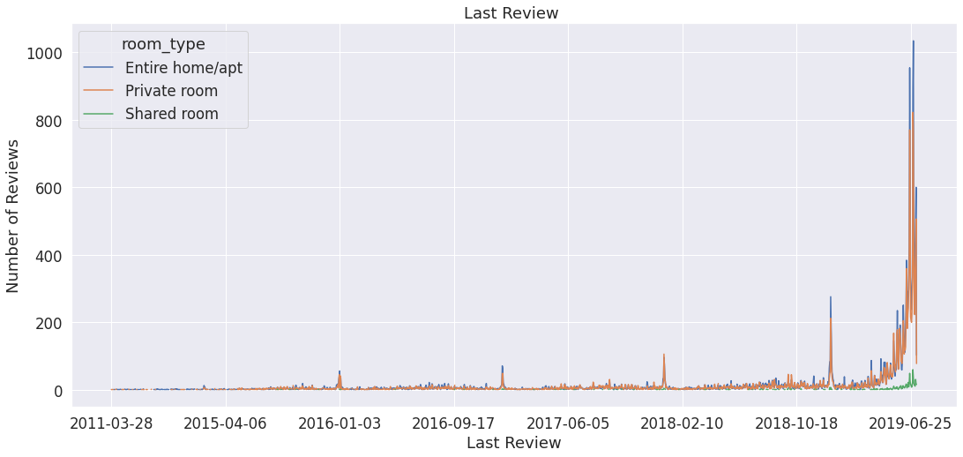
Maximum Reviews per year

Slide 23
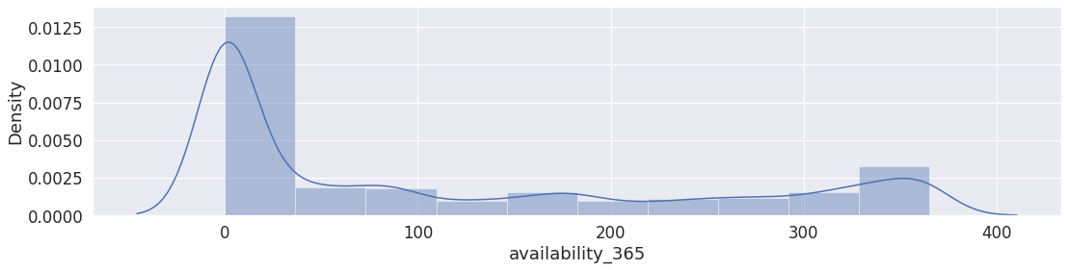
Availability

Slide 24
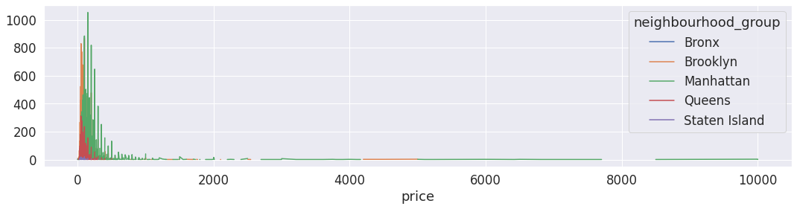
Lowest prices preferred

Slide 25
Conclusion
Most number of hosts prefer to stay in Brooklyn / Manhattan
Most of them prefer to stay Entire home/ apartment followed by private rooms, shared rooms less preferred
Most of the guest like to stay less than 3 days
We have realized that the popularity of Airbnb has increased a lot since 2019 as the number of reviews have been exceedingly large
Most of the hosts prefer to stay for short durations and only Manhattan and Brooklyn neighborhood groups avail bookings for short durations
Last but not the least Brooklyn / Manhattan has highest booking as they are the cheapest

Slide 26
Challenges
1. We had to go through a vigorous amount of data without eliminating any bootless data.
2. The selection of datasets having distinctive attribute to give us a productive conclusion was time consuming.
3. Discovering relationships between features and explaining each by plotting was laborious.

